Slide 1
Computer Programming 2 using Java
Instructor: Pet Andrew P. Nacua, MIT
Notes:
https://www.geeksforgeeks.org/c-language-set-1-introduction/
https://www.tutorialspoint.com/cprogramming/c_basic_syntax.htm

Slide 2
Lessons:
Multi-dimensional Array
2
2

Slide 3
Learning Outcomes:
Understand the concepts of computer programming
Formulate logical steps in solving a problem
Distinguish data from information
Apply correct data types in variables
Code a simple program
3

Slide 4
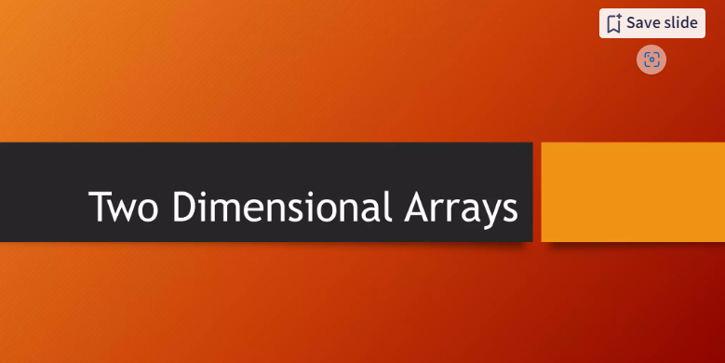

Slide 5
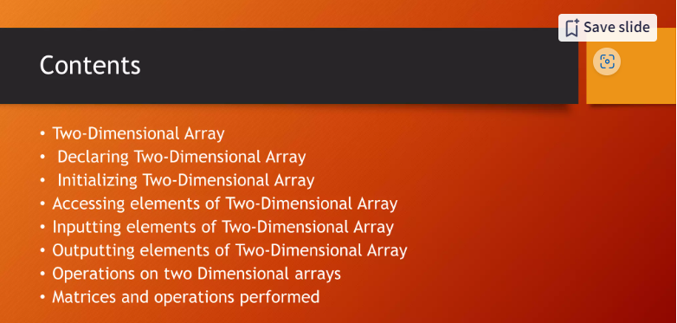

Slide 6
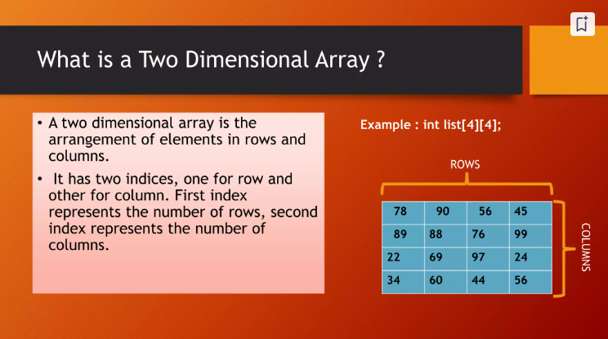

Slide 7
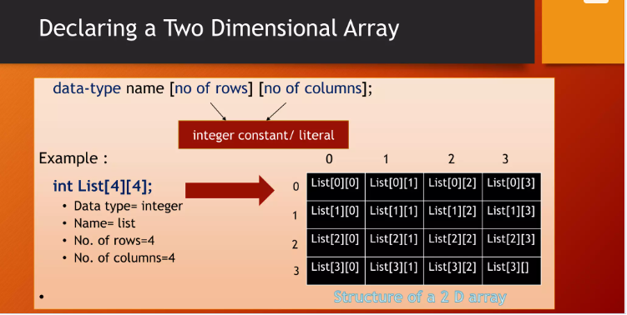

Slide 8
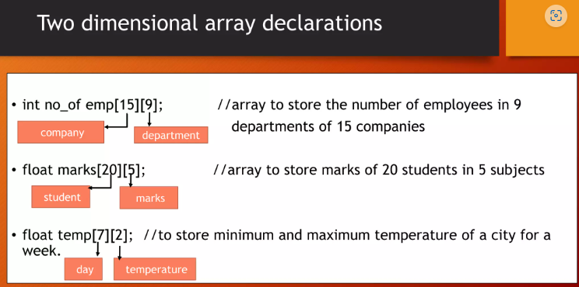

Slide 9
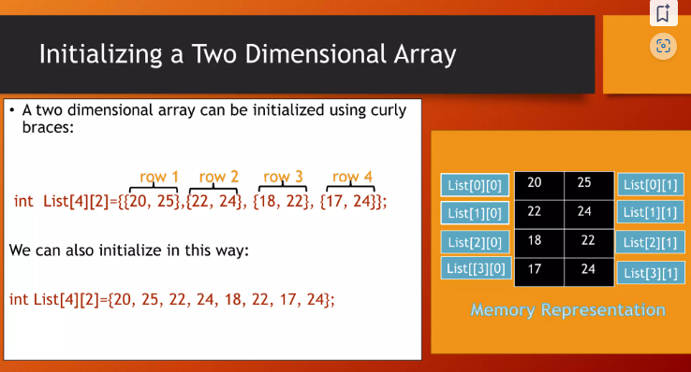

Slide 10
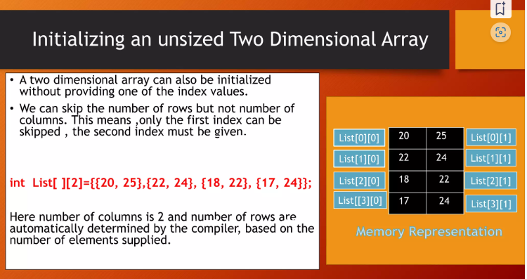

Slide 11
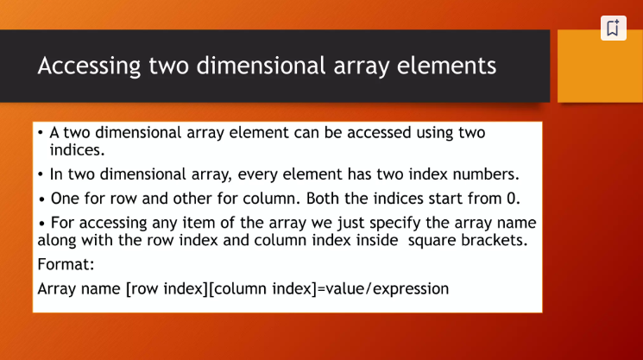

Slide 12
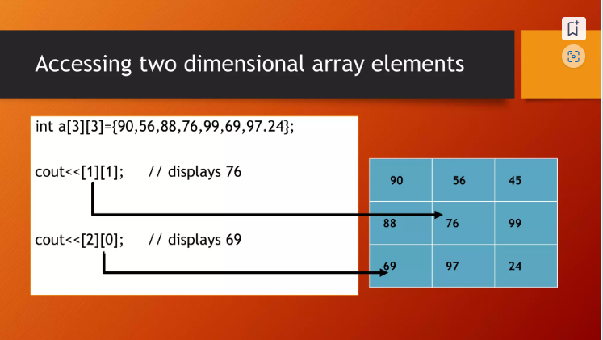

Slide 13
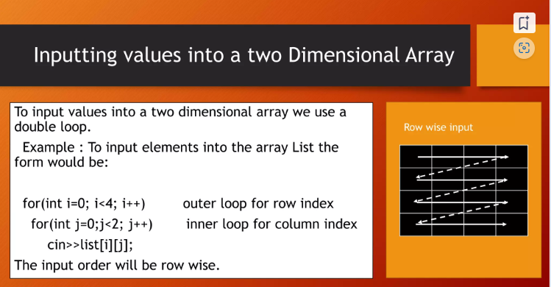

Slide 14
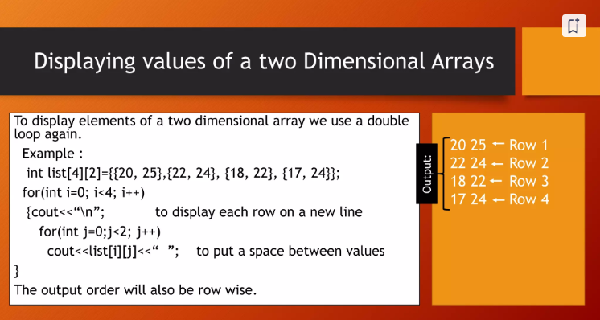

Slide 15
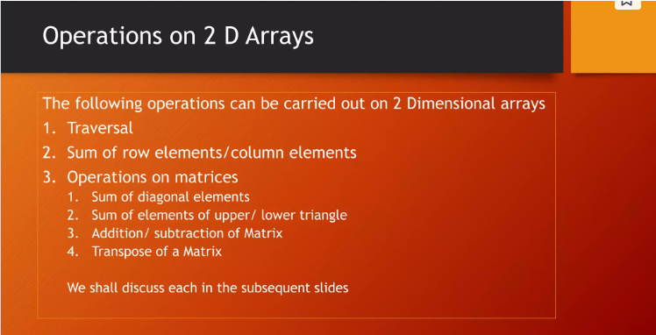

Slide 16
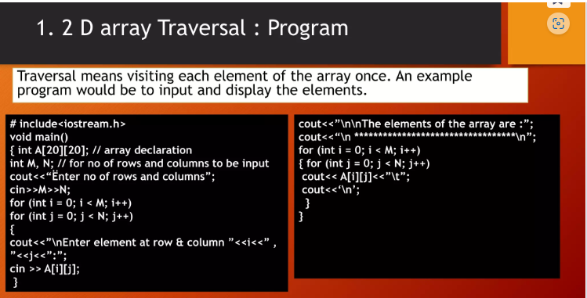

Slide 17
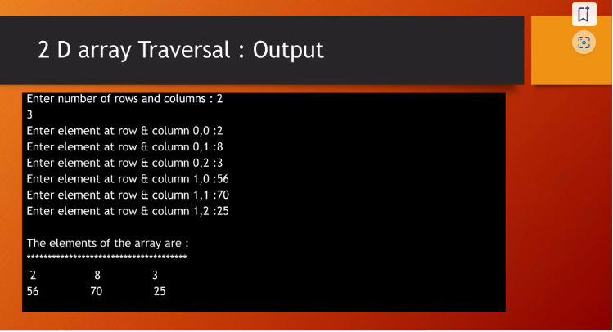

Slide 18
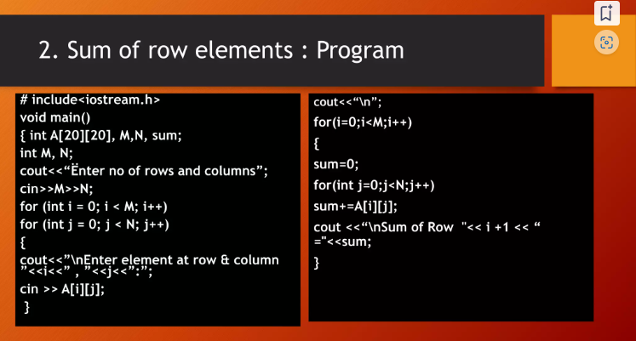

Slide 19
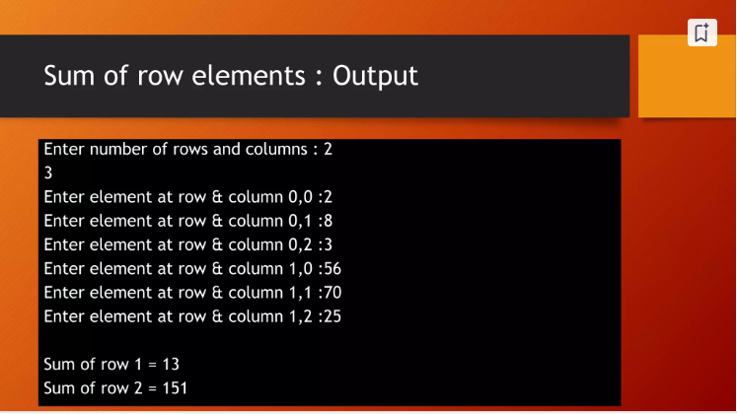

Slide 20
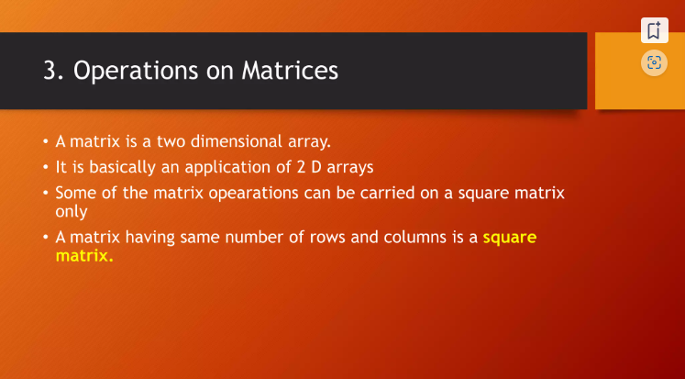

Slide 21
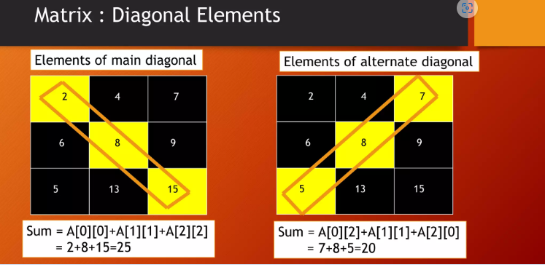

Slide 22
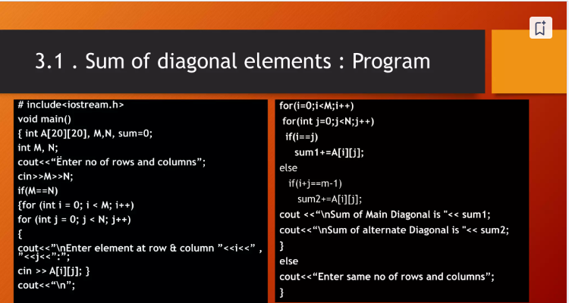

Slide 23
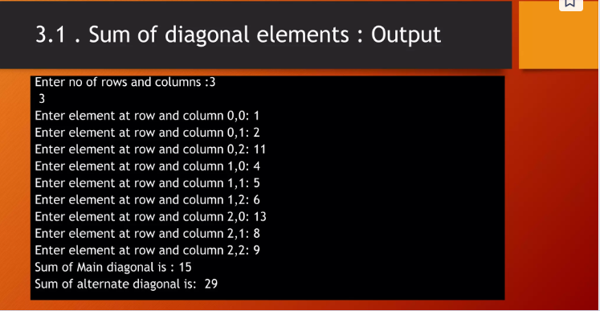

Slide 24
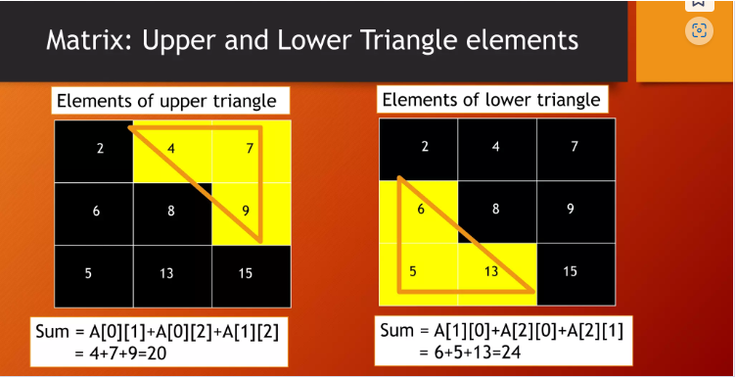

Slide 26
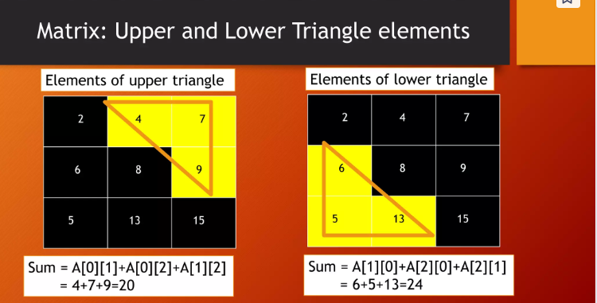
1.

Slide 27
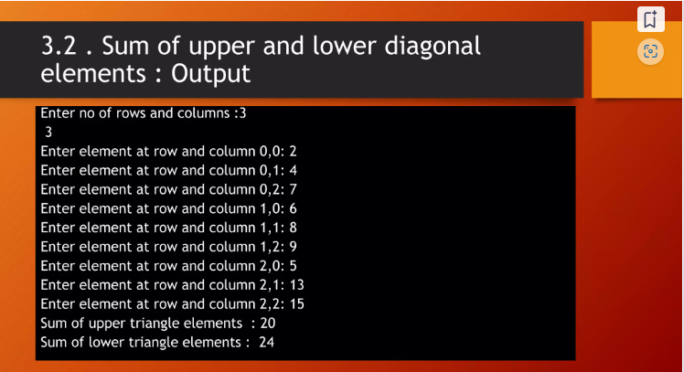

Slide 28
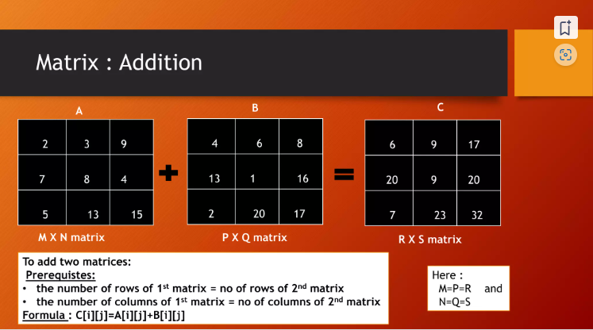
2.

Slide 29
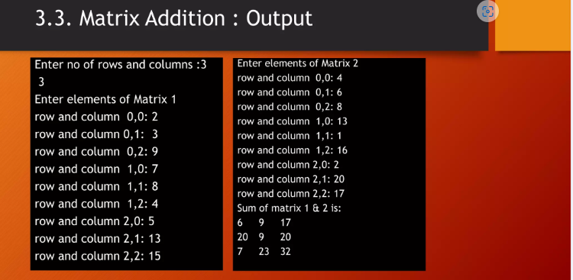

Slide 30
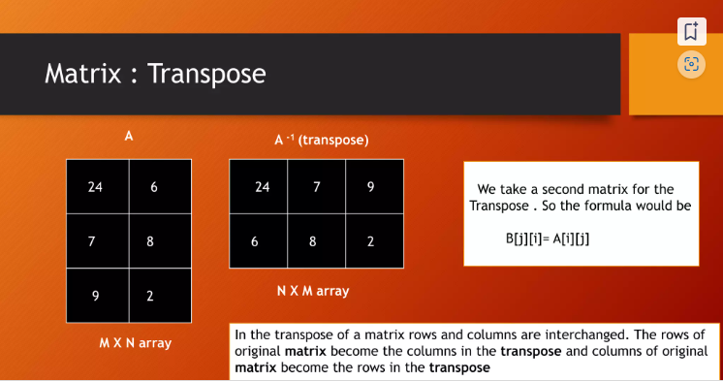
3.

Slide 31
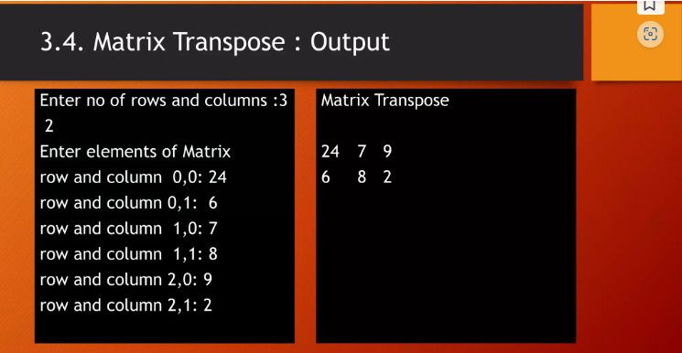

Slide 32
SlidesCarnival icons are editable shapes.
This means that you can:
Resize them without losing quality.
Change fill color and opacity.
Isn’t that nice? :)
Examples:

Slide 33
😉
Now you can use any emoji as an icon!
And of course it resizes without losing quality and you can change the color.
How? Follow Google instructions https://twitter.com/googledocs/status/730087240156643328
✋👆👉👍👤👦👧👨👩👪💃🏃💑❤😂😉😋😒😭👶😸🐟🍒🍔💣📌📖🔨🎃🎈🎨🏈🏰🌏🔌🔑 and many more...

